Slide 1
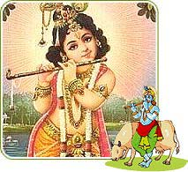
Sri Krishna Janmashtami
(Celebration of Birth of Sri Krishna)

Slide 2
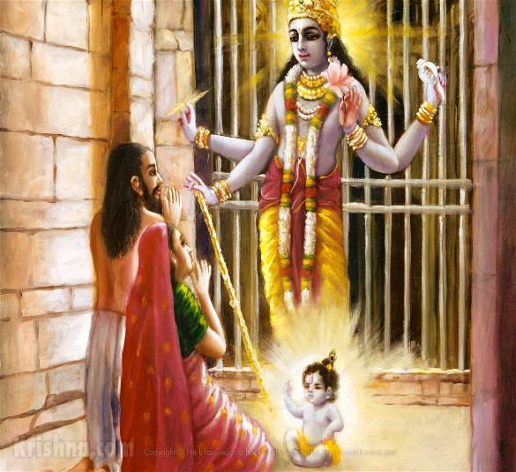
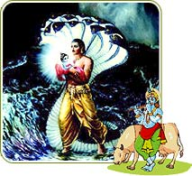
Birth of Sri Krishna
Sri Krishna was born in Mathura to Devki and Vasudev in a prison at midnight. He was their eighth child.
Sri Krishna was born on the eighth day (Ashtami) of second fortnight in Sravana month in Dwapur Yug.
To escape King Kamsa (brother of Devki) of Mathura, Vasudev
left Sri Krishna at Nanda and Yashoda’s house in Gokul.

Slide 3
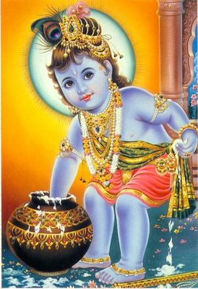
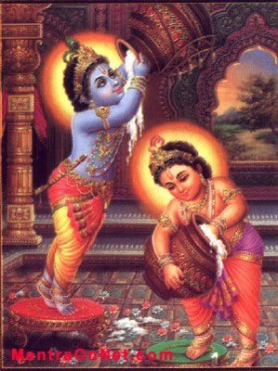
Sri Krishna Bal Leela
Sri Krishna loved Yogurt
Sri Krishna along with his friends used to steal Yogurt when Yashoda Maiya was not watching them

Slide 4
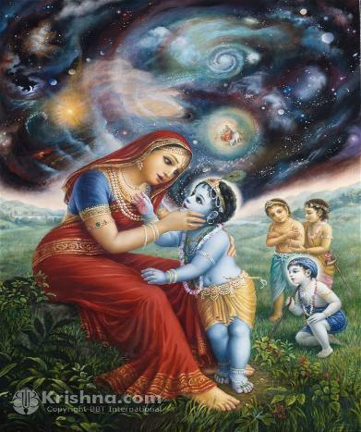
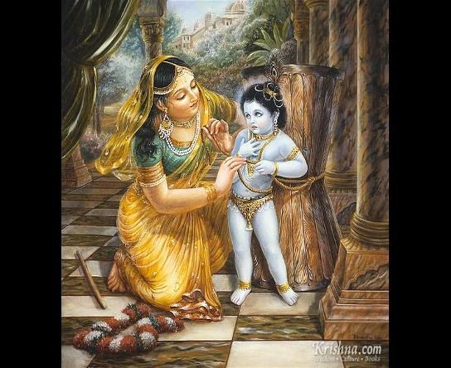
Sri Krishna Bal Leela
One day Balarama and the other boys complained to Yasoda that Krishna had eaten earth. Yasoda got afraid that this might affect Sri Krishna's health. She rebuked Krishna, "O my naughty child! Why did you eat earth in secret?" Sri Krishna replied, "O mother! I did not eat earth. These boys have told a lie. Examine my mouth." Yasoda said, "Open your mouth, my child!" Sri Krishna opened His mouth. Therein she saw the whole universe of animate and inanimate things. She was amazed and realized Sri Krishna is god.
One day Yasoda was churning the curd herself and singing the deeds of her son. Krishna came to His mother. Yasoda went to remove boiling milk from the oven. Krishna began to eat butter stealthily. Yasoda came back after a short time and found the pot of curd broken to pieces. Krishna had already left the place. Yasoda at once guessed that it was her son's doing. She tried to tie Him to the husking-stand with a cord; but when she began to bind Him the cord was found to be short by a few inches. She brought another piece of cord and joined it to the original one. With every other piece she added, the rope was still short by a few inches. She got amazed. Krishna found out that His mother was thoroughly exhausted and her body was bathed in sweat. He took pity on her and allowed Himself to be bound to the husking-stand.

Slide 5
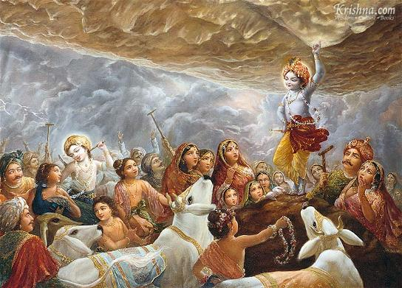
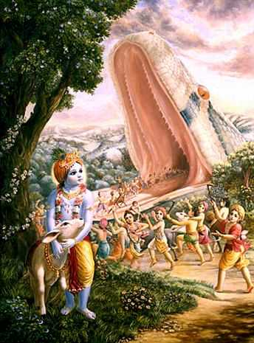
Sri Krishna’s Brave Acts
As per the story, Krishna saw huge preparations for the annual offering to Lord Indra and questions his father Nanda about it. He debated with the villagers about what their 'dharma' truly was. They were farmers, they should do their duty and concentrate on farming and protection of their cattle. The villagers were convinced by Krishna, and did not proceed with the special puja (prayer). Indra was then angered, and flooded the village. Krishna then lifted Mt Govardhan and held it up as protection to his people and cattle from the rain. Indra finally accepted defeat and recognized Krishna as supreme.
One day Krishna was playing with the boys in the forest. At that time a mighty Asura called Agha, who was the younger brother of Putana and Bakasura, came there under the direction of Kamsa.
The wicked Asura assumed the huge body of a boa-constrictor, one Yojana (8 miles) in length and stout like a big hill. It kept open its cave-like mouth in order to swallow Krishna and his associates. All the boys with all their calves clapped their hands and with a smile entered the mouth of the serpent. The serpent did not close its mouth. Krishna entered the mouth of the serpent and expanded Himself to huge dimensions in the throat of the Asura. The Asura died.

Slide 6
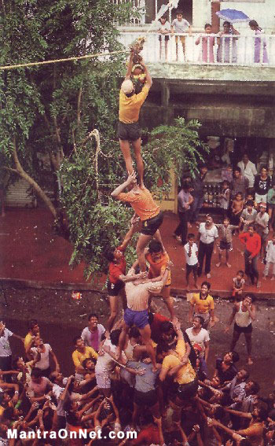
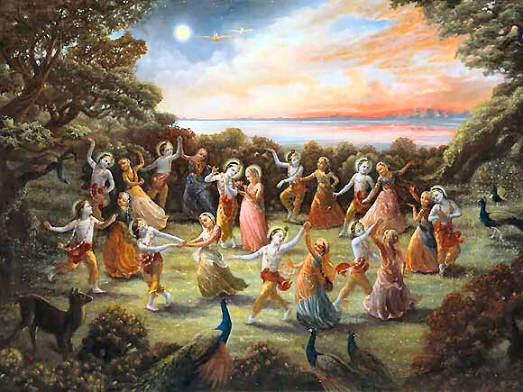
How we celebrate Sri Krishna Janmashtami
Dahi Handi
Rasa Lila in Vrindavan

Slide 7
What is special about Lord Krishna’s Picture
The Peacock feather in his crown
The Flute/Bansuri in his hand
Usually a cow around him

Slide 8
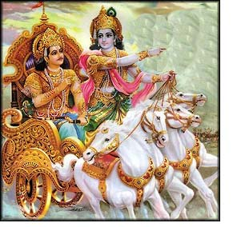
Learnings from Sri Krishna are captured in
Bhagwad Gita- Divine Songs of Lord

